Slide 1
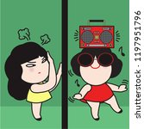
Private Nuisance
John Murphy

Slide 2

PRIVATE NUISANCE
I. Scope of the Tort
Definition
Leung Tsang Hung v Incorporated Owners of Kwok Wing House (2007) 10 HKCFAR 480
“Private nuisance is a tort protecting property rights. It is concerned with the activities of the owner or occupier of
property within the boundaries of his own land which may harm the interests of the owner or occupier of other land”.
My definition in The Law of Nuisance (Oxford: OUP, 2010) p 1
“A substantial and unreasonable interference with a person’s land or the use or enjoyment of that land”.
Jalla v Shell International Trading and Shipping Co Ltd [2023] UKSC 16 [citing me, among others]:
“the tort of private nuisance is committed where the defendant’s activity, or a state of affairs for which the defendant is
responsible, unduly interferes with (or, as it has commonly been expressed, causes a substantial and unreasonable
interference with) the use and enjoyment of the claimant’s land”. (Lord Burrows).
NB Fearn v Board of Trustees of Tate Gallery [2023] UKSC 4

Slide 3

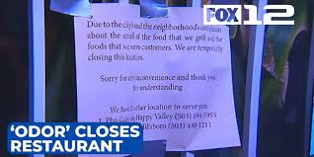
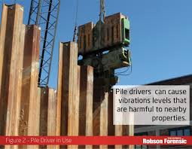
B. Background
Despite its manifold forms, in Hong Kong, many of the cases on this tort—probably unsurprisingly—apply to water leakage rather than noisy neighbours.
But bear in mind, disputes between domestic neighbours are not all of what nuisance is about. For one’s neighbour could well be a factory, a bar or a sports ground.
NB Flat owners might prefer the contract action under the Deed of Mutual Covenant.

Slide 4
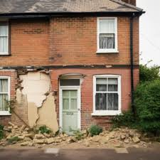
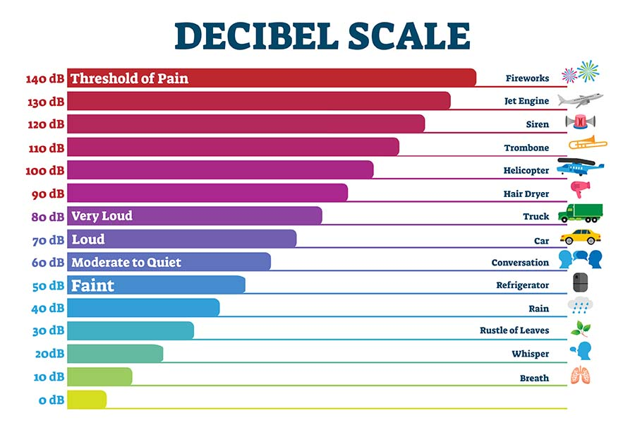
C. “Substantial Interference”
To sue, a nuisance must be substantial. In other words, the principle of de minimis non curat lex applies.
Walter v Selfe (1851) 4 De G & Sm 315
“[O]ught this inconvenience to be considered in fact as more than fanciful, more than one
of mere delicacy or fastidiousness, as an inconvenience materially interfering with the
ordinary comfort physically of human existence, not merely according to elegant or
dainty modes and habits of living, but according to plain and simple notions among the
English people?” (Knight Bruce VC)
Fearn v Board of Trustees of Tate Gallery [2023] UKSC 4
“[T]he first question which the court must ask is whether the defendant’s use of land has
caused a substantial interference”. (Lord Leggatt) (Lords Reed & Lloyd-Jones agreed)
To answer the question of whether there has been a substantial interference, the courts have highlighted a few factors that help identify when one has occurred.

Slide 5
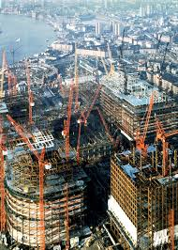
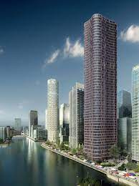
1 Unusual Sensitivity of the Claimant If a claimant is abnormally sensitive, this may be an indication that, although C is greatly irritated or affected, this may still not amount to a material interference. Robinson v Kilvert (1889) 41 Ch D 88 “It would, in my opinion, be wrong to say that the doing something not in itself noxious is a nuisance because it does harm to some particular trade in the adjoining property, although it would not prejudicially affect any ordinary trade carried on there, and does not interfere with the ordinary enjoyment of life”. (Cotton LJ). Hunter v Canary Wharf [1997] 2 All ER 426 Fearn v Board of Trustees of Tate Gallery (above). “The particular sensitivities or idiosyncrasies of those individuals are therefore not relevant, and the law measures the extent of the interference by reference to the sensibilities of an average or ordinary person”. (Lord Leggatt) Capital Prosperous Ltd v Sheen Cho Kwong [1999] 1 HKLRD 633 NB Abnormally sensitive buildings can be distinguished: Fearn (above) “it is the utility of the actual land, including the buildings actually constructed on it, for which the law of private nuisance provides protection - not for some hypothetical building of ‘average’ or ‘ordinary’ construction and design”. (Lord Leggatt)

Slide 6

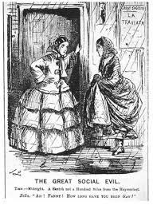
2 Location of Claimant’s Premises C’s neighbourhood helps govern C’s legitimate expectations re. peace and quiet etc. Sturges v Bridgman (1879) 11 Ch D 852 “What would be a nuisance in Belgrave Square would not necessarily be so in Bermondsey”. (Thesiger LJ) Thompson-Schwab v Costaki [1956] 1 All ER 652 “the test [is] … whether what is being done interferes with the plaintiffs in the comfortable and convenient enjoyment of their land, regard being had … to the character .. of the neighbourhood”. (Evershed MR) Tam Seen Mann Estefania v Chan Norman and Another (Unreported HCA 627/2010) “A useful test which balances the interest between neighbours … is what is reasonable according to ordinary usages of mankind living in a particular society. In … Hong Kong, the court should take into account the particular habits of Hong Kong people, in particular later bedtimes”. NB Locality is not relevant in cases of property damage. * St Helens Smelting Co v Tipping (1865) 11 HL 642 * ACL Electronics (HK) Ltd v Bulmer Ltd [1992] 1 HKC 133

Slide 7
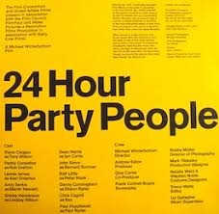
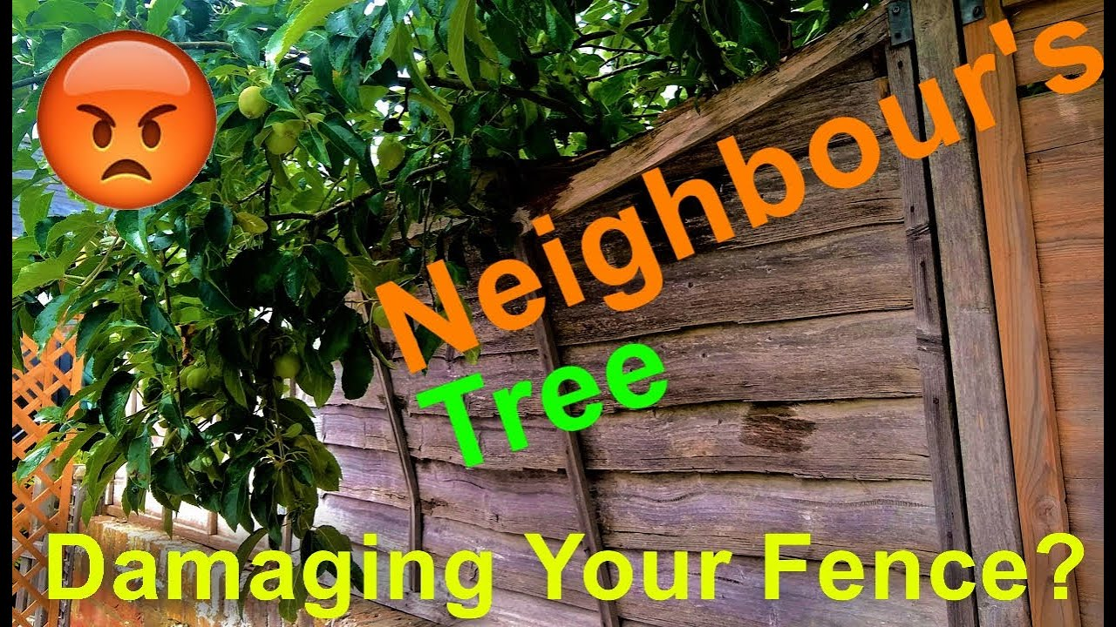
D. “Unreasonable Interference” Lord Leggatt’s doubts in Fearn aside, this important requirement is a description of the nature of the effect on C (rather than a characterisation of the way that D behaves). NB Strict liability = liability regardless of personal fault, not liability without fault. Certain factors shine some light on what is entailed by an unreasonable interference. 1. Seriousness of the Interference. (a) Duration The longer an interference = more serious = more unreasonable. Matania v National Provincial Bank [1936] 2 All ER 633 “the law, in judging what constitutes a nuisance, does take into account both the object and duration of that which is said to constitute the nuisance”. (Slesser LJ) (b) Character of the Harm It is generally more difficult to justify physical damage to C’s land than amenity nuisance. St Helens Smelting Co v Tipping (supra): locality has no exculpatory value in property damage cases.

Slide 8
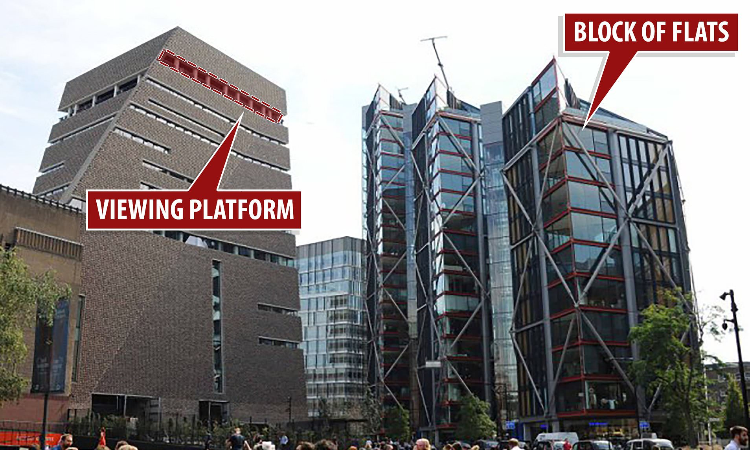
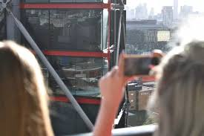
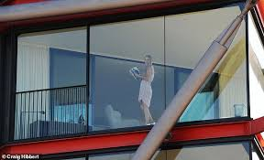
2 Character of the Defendant’s User Fearn (above) [Now the leading authority on what a reasonable user entails.] “The two conditions of [reasonable user are whether] … the acts complained of were (i) necessary for the common and ordinary use and occupation of land, and (ii) ‘conveniently done’ - that is to say, done with proper consideration for the interests of neighbouring occupiers”. NB If you make an unnecessary/abnormal use of your property, you will fail at limb (1) to show a reasonable user. But even if you don’t fail at limb (1), you may still fail at limb (2). Ultimately, it was because D (an art gallery) was providing the public with the chance to intrusively view the Ps that its user was considered unreasonable. It was not “necessary for the ordinary occupation land”. “Inviting several hundred thousand visitors a year to look out at the view from your building cannot by any stretch of the imagination be regarded as a common or ordinary use of land”. (Lord Leggatt). Several other factors help illuminate things further…

Slide 9

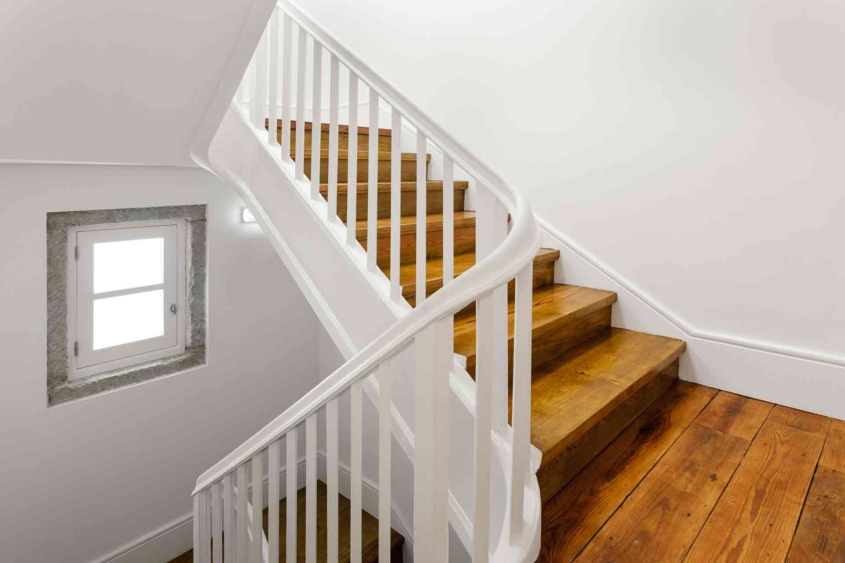
(a) D’s malicious activities Though liability in nuisance is technically strict, the malice in D’s user can be a material consideration since if D’s user is malicious, he can never justify the interference thereby caused. Hollywood Silver Fox v Emmett [1936] 2 KB 468 Pong Seong Teresa v Chan Norman [2014] 6 HKC 515 “Where noise is created deliberately and maliciously for the purposes of causing annoyance, its mala fides character alone would render it an actionable nuisance even if it would otherwise have been legitimate”. (Linda Chan SC) (b) Locality in which D’s activities occur Just as C’s location is relevant to the question “what can we reasonably expect C to put up with?” so, too, is D’s location relevant to the issue of “what is it acceptable for D to do?” Ball v Ray (1873) 8 Ch App 467

Slide 10
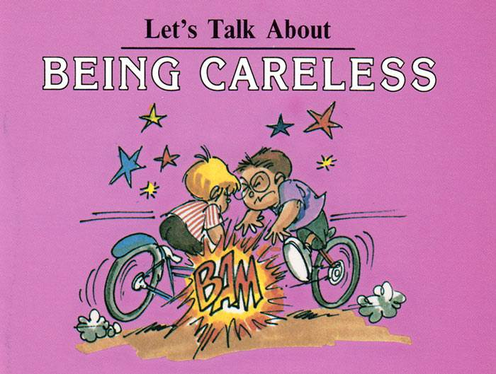
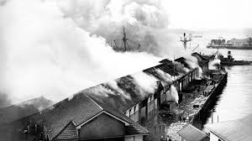

(c) Fault on D’s Part? The Wagon Mound (No 2) [1967] 1 AC 617 “Nuisance .. [covers] a wide variety of tortious acts or omissions and in many negligence in the narrow sense is not essential. An occupier may incur liability for the [e]mission of noxious fumes or noise although he has used the utmost care in building and using his premises ... [But] although negligence may not be necessary, fault of some kind is almost always necessary and fault generally involves foreseeability”. (Lord Reid) Lau Chun Wing Rod v Incorporated Owners of Po On Building [2006] HKCU 1364 “It is settled law that the exercise of care and skill by a competent contractor or every effort made by the Defendant to prevent a nuisance afford no defence”. (Wong J) Tin Kin Ka Clara v Chan Koon Cheong [2015] HKCU 1029 “to prove nuisance in a seepage case … a plaintiff must show, besides the seepage … that (i) the defendants actually or constructively knew that the water originated from their premises; and (ii) remedial action was not taken within a reasonable time”. (Li J). (d) The practicability of avoiding an interference If D could have taken simple steps to avoid disturbing C, the fact that D does not take those steps may be taken by the courts to support a finding of unreasonable interference. Leeman v Montagu [1936] 2 All ER 1677

Slide 11


II Who Can Sue in Private Nuisance? The House of Lords, in a landmark decision, set firmly in place the rule that in order to sue in private nuisance C must have a proprietary interest in the land affected. Hunter v Canary Wharf [1997] 2 All ER 426 “[A]n action in private nuisance will only lie at the suit of a person who has the right to the land affected ... a mere licensee on the land has no right to sue”. (Lord Goff). This principle has been applied locally. Ng Hoi Sze v Yuen Sha Sha [1999] 3 HKLRD 890 “[T]he action is not one for causing discomfort to the person but is one which arises because the utility of the land has been diminished by reason of the existence of the nuisance. It is for that reason that mere presence on the land of the Plaintiff is not sufficient. For a Plaintiff to have a cause of action in nuisance, he must have a right to the land”. (Rogers JA)

Slide 12

III Recognised Heads of Loss in Private Nuisance Physical damage = well recognised (See St Helens and Jalla cases (above)). So, too, is amenity nuisance like noise/smell. As is intrusive viewing. Fearn (above) “the claimants’ complaint is indeed one of damage to interests in property. The concepts of invasion of privacy and damage to interests in property are not mutually exclusive. An important aspect of the amenity value .. Is the freedom to conduct your life in your own home without being constantly watched and photographed by strangers”. (Leggatt). A. Personal Injury Hunter (above) “The injury to the amenity of land consists in the fact that persons on it are liable to suffer inconvenience, annoyance or illness”. (Lord Hoffmann) “In the case of nuisances “productive of sensible personal discomfort”, the action is not for causing discomfort to the person but ... for causing injury to the land”. (Lord Hoffmann) Fearn (above) “the harm from which the law protects a claimant is personal discomfort to the persons who are occupying it”. (Lord Leggatt). Yuen Sha Sha case (above): same reasoning adopted by Godfrey JA.

Slide 13

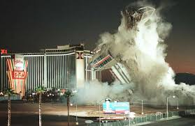
B. Damage to Chattels Damage to chattels also recoverable … with a twist. Anglian Water Services Ltd v Crawshaw Robbins & Co Ltd [2001] BLR 173 [I]it is possible to regard the interruption to the supply of gas as an interference with the use of gas appliances rather than with a use of land [since replacement electrical appliances can be obtained]. (Stanley Burnton J). C. Economic Loss Consequential economic loss so long as it derives from interference with land’s amenity is recognised as recoverable. Andrae v Selfridge [1938] Ch 11

Slide 14
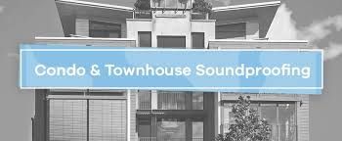

IV Who Can be Sued? A. Creators of the Nuisance The action in private nuisance will not necessarily always be against the owner of neighbouring land. The law states that he who has created the nuisance will be liable. Southwark LBC v Mills [2001] AC 1 (No liability, on facts) “Nuisance involves doing something on adjoining or nearby land which constitutes an unreasonable interference with the utility of the plaintiff’s land. The primary defendant is the person who causes the nuisance”. Loke Yuen Jean Tak Alice v Wong Kit Ying [2019] HKCU 2916 “The person to be sued for nuisance is the one who has possession and control of the land from which the nuisance emanated … If a nuisance arises prior to a letting, the owner/landlord does not cease to be liable by virtue of parting with possession. If he knew of the potentially harmful condition of the property before letting, or ought to have known of it, he remains liable for harm accruing after the letting… If the nuisance arises after the tenancy is granted, Lord Neuberger PSC in Lawrence & anor v Fen Tigers Ltd & ors (No 2) said as follows: “Lord Millett explained in Southwark London Borough Council v Mills [2001] 1 AC 1, 22, that, where activities constitute a nuisance, the general principle is that ‘the … persons directly responsible for the activities in question are liable; but so too is anyone who authorised them’”. (Ng J.)

Slide 15
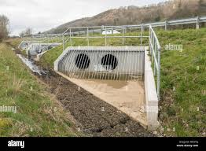
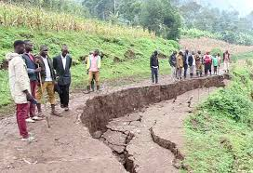
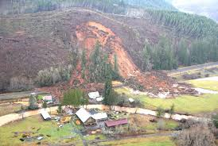
B. Occupiers A fuller picture of occupiers’ potential liability can be put as follows. Occupier may be liable, even though they did not themselves create the nuisance where: * They adopted or continued the nuisance created by another * They adopted or continued a nuisance created by natural processes * They have control over the creator of the nuisance (as per Loke Yuen Jean, above) NB 1 One adopts a nuisance when one makes use of the state of affairs comprising the nuisance. [Sedleigh Denfield = authority.] NB 2 One continues a nuisance where one fails to abate a nuisance where one has actual or constructive knowledge of the nuisance. [Sedleigh Denfield = authority.] Sedleigh‑Denfield v O’Callaghan [1940] AC 880 (owner/occupier liable for nuisance created by another if he adopts/continues it). Leakey v National Trust [1980] QB 485 (liability for adopting/continuing nuisances caused by nature: very dry bank of earth liable to result in landslide after heavy rain). Matania v National Provincial Bank [1936] 2 All ER 633 (liability for acts done by those over whom owner/occupier had control: independent contractors in this case). Leung Tsang Hung v Incorporated Owners of Kwok Wing House (2007) 10 HKCFAR 480

Slide 16
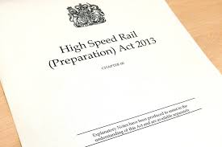
V Defences A. Prescription If you use land a particular way for 20 years without complaint, then you acquire a prescriptive right to continue to do so. Sturges v Bridgman (1879) 11 Ch D 852 Coventry v Lawrence [2014] UKSC 13 B. Statutory Authority Statutory authority = a defence. But hard questions of interpretation may still arise. Allen v Gulf Oil Refining Ltd [1981] AC 1001 Manchester Ship Canal Co Ltd v United Utilities Water Ltd [2024] UKSC 22 “Applying the general principles … the question … [is] whether there was any provision of the relevant legislation which expressly or impliedly authorised such a trespass or private nuisance”. (Lords Reed and Hodge.) Lam Yuk Fong v A-G [1987] HKLR 263 “in order to dismiss this action I have … to be satisfied that there was no other way of doing this work”. (Saied J.) Cf Coventry v Lawrence (supra) [Planning Permission] “the decision whether the activity causes a nuisance to the claimant is not for the planning authority but for the court, the existence and terms of the permission are not irrelevant as a matter of law”. (Lord Neuberger.)

Slide 17

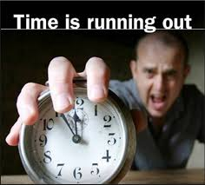
C. Acts of God/Strangers Inevitable accidents of nature and nuisances created by third parties which are neither adopted nor continued by D (in the senses discussed above) will not support an action in nuisance against D. Sedleigh-Denfield v O’Callaghan (supra) If you don’t know, or have constructive knowledge of the problem, then you won’t be liable. D. Limitation All civil actions must be brought within a statutorily specified period. For nuisance it is 6 years. But also well-established that with ongoing nuisances, a fresh cause of action arises each day. Delaware Mansions Ltd v Westminster City Council [2002] 1 AC 321. So what happens in a case where, because of the way D conducts operations on their premises, an escape of something (eg, oil) occurs that has a lingering effect on C? Jalla v Shell International Trading and Shipping Co Ltd [2023] 2 WLR 1085 “There was no continuing nuisance in this case (and there would be no continuing nuisance in the example of the one-off flood) because, outside the claimants’ land, there was no repeated activity by the defendants or an ongoing state of affairs for which the defendants were responsible that was causing continuing undue interference with the use and enjoyment of the claimants’ land”. (Lord Burrows.)

Slide 18
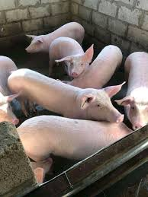

VI Remedies A. Injunctions Injunctions are the remedy of choice, here. In fact, they are presumptively granted in nuisance cases. Shelfer v City of London Electric Lighting Co [1895] 1 Ch 287 “Where the injury … (i) small; (ii) capable of being estimated in money; (iii) [compensable]… by a small money payment, and (iv) … it would be oppressive … to grant an injunction”. (Smith LJ) Occasionally, courts refuse injunctions. Gravity of interference and public interest are salient, here. Cooke v Forbes (1867) LR 5 Eq 166 (gravity of interference) Wheeler v JJ Saunders Ltd [1995] 2 All ER 697 (public interest) Fearn (above) “[T]he public interest… [isn’t] relevant to the question of liability … [It is relevant] only, where liability is established, to the question of what remedy to grant”. (Lord Leggatt) NB Even if an injunction is refused, D may still have to pay damages in lieu. Coventry v Lawrence (supra) “[T]he court might well … [grant damages in lieu where] an injunction would involve a loss to the public or a waste of resources on account of what may be a single claimant”. (Lord Neuberger) Lo Yu Chu v Kam Fu Lai Development Co Ltd [1994] 3 KKC 18 “If [3rd parties] … consider that the effect on them of an injunction will be … [very] damaging … there is nothing to prevent them … [seeking] to have the injunction set aside. (Penlington JA)

Slide 19
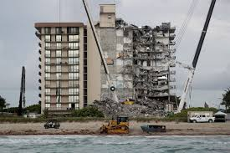
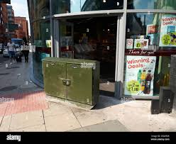
B. Damages As regards damages, the idea is to pay to C the difference between the value of the protected interest before and after the nuisance. Andreae v Selfridge & Co [1938] Ch 1 Wong Shiu Hung v Lui Kuo [2001] HKCU 551 NB In cases of physical loss, damages are measured in two ways: (1) cost of repair or (2) drop in property value (whichever is lower).

Slide 20


